Slide 1
Unit 4
Describing Methodology

Slide 2
Objectives
To get to know what research methodology is mainly concerned with
To understand the importance of the passive voice in academic writing
To learn to be skilled in using sequential markers in writing a process paragraph
To get familiar with proofreading skills
To learn to design a good questionnaire

Slide 3
Contents
1
Definition of Methodology
2
Data Collection Methods
3
Questionnaire Design
4
Methodology Section Writing
5
Language Focus & Writing Practice

Slide 4


What is Methodology?
method + -ology
the study of method
1. the systematic, theoretical analysis of the methods applied to a field of study, or the theoretical analysis of the body of methods and principles associated with a branch of knowledge;
2. the analysis of the principles of methods, rules, and postulates employed by a discipline;
3. the systematic study of methods that are, can be, or have been applied within a discipline;
4. the study or description of methods
--Wikipedia
Notes:
First ask students to define the term “methodology” and then display the definition taken from Wikipedia to the students. Ask the students to find out the key word “methods” in them after reading

Slide 5
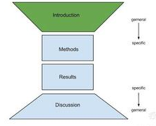
About methodology section in research paper
In natural sciences:
Materials and Methods
In social sciences:
Theories and Methods
(Theoretical Framework
and Methods)
Why is a particular research undertaken?
How has one formulated a research questions?
What types of data have been collected?
What particular methods have been used?
Why is a particular technique used to analyze data?

Slide 6


What Methods for Collecting Data?
Desk research
Data Collection Methods
Field research
Secondary Data
Primary Data
Review literature
Experiment
Survey
In-depth interview
observation
Mail
Telephone
Questionnaire
Personal Interview
Online
Field
Lab
Qualitative Data
Quantitative Data
Notes:
Since methodology section is mainly concerned with methods used to collect data, ask the students to discuss in small groups to make a list of the methods. Learn about the details of the methods by visiting http://hafeezrm.hubpages.com/hub/Data-Collection-Methods

Slide 7

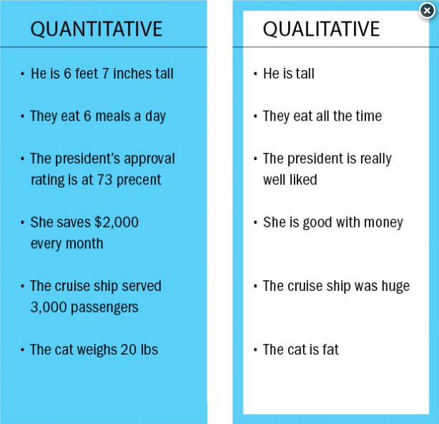
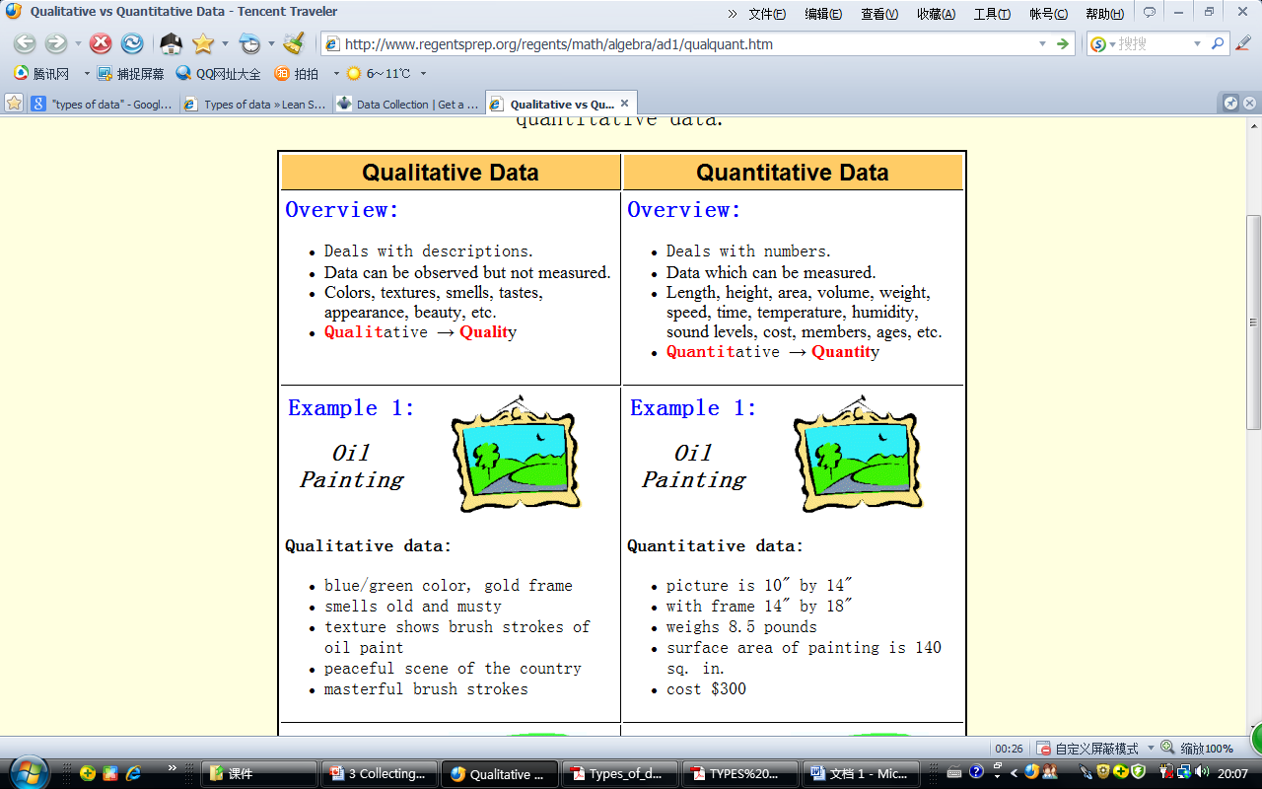
Qualitative data vs. quantitative data?

Slide 8

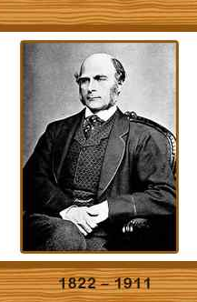
What is a questionnaire?
a research instrument consisting of a series of questions and other prompts for the purpose of gathering information from respondents
a data-gathering device that elicits from a respondent the answers or reactions to pre-arranged questions presented in a specific order
a series of questions asked to individuals to obtain statistically useful information about a given topic
a group of printed questions used to collect information from the people who answer them (usually called respondents)
The questionnaire was invented by Sir Francis Galton.
Notes:
http://en.wikipedia.org/wiki/Questionnaire
http://www4.caes.hku.hk/acadgrammar/report/repproc/sections/methods/question.htm
http://en.wikipedia.org/wiki/Questionnaire_construction

Slide 9

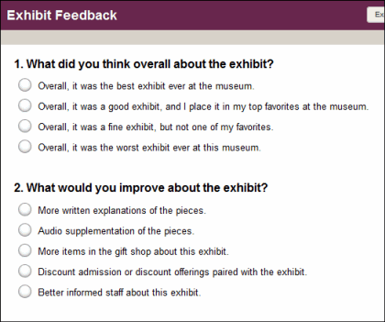
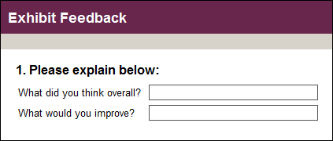

Question Types?
Close-Ended vs. Open-Ended Questions

Slide 10


Steps to design a questionnaire?
Nine steps in questionnaire design:
1. Decide the information required.
2. Define the target respondents.
3. Choose the method(s) of reaching your target respondents.
4. Decide on question content.
5. Develop the question wording.
6. Put questions into a meaningful order and format.
7. Check the length of the questionnaire.
8. Pre-test the questionnaire.
9. Develop the final survey form.

Slide 11
Pros and Cons of Open and Closed Questions
Open questions | Closed questions
Elicit “rich” qualitative data | Elicit quantitative data
Encourage thought and freedom of expression | Can encourage ‘mindless’ replies
May discourage responses from less literate respondents | Are easy for all literacy levels to respond to
Take longer to answer and may put some people off | Are quick to answer and may improve your response rate
Are more difficult to analyze – responses can be misinterpreted. | Are easy to ‘code’ and analyze

Slide 12

Practice designing a questionnaire
Ask the students to work in groups in an attempt to design a questionnaire to obtain information about students’ attendance and causes for their absence.

Slide 13

P40-41
Reading activity
Research objective
Research subjects
Research location
Materials
Procedure
Statistical analysis
Investigate perceptions of English needs in a medical context among college students in Taiwan
341 medical students in the Department of Medicine, including 97 freshmen, 74 sophomores, 90 juniors, and 80 seniors, and 20 faculty members in the medical program
Fill in the table with information from the reading passage
Chung Shan Medical College in Taichung, Taiwan, China
Two questionnaires
The questionnaire was given to the medical students. The faculty questionnaire was given to 20 teachers.
The data were computer-analyzed using an SPSS program.
Notes:
Ask the students to read the passage on P40-41 and do Ex. 1.3.1 and Ex. 1.3.2, And finishing do the exercises, ask to students to discuss in small groups and figure out what are included in the methodology section

Slide 14

What are Included in the Questionnaire to the students and the faculty?
The questionnaire to the students includes 5 sections with 23 questions:
demographic information
importance of English in college and professional careers
perceived language skill needs and problems
the activities needed in a freshman language course
suggestions for development of course content and materials as well as demographic information.
The questionnaire to the faculty with 16 questions in 4 sections

Slide 15

What may be included in methodology section?
1) Overview of the experiment: one sentence briefly tells what was done (like a topic sentence);
2) Population: state the people/subjects studied, or the things tested;
3) Location: where the study took place;
4) Restriction/Limiting conditions: precautions taken to make sure that the data are valid;
5) Sampling Techniques: describe how the subject are selected for the study;
6) Materials: describe the materials used to conduct the study or experiment;
7) Procedures: State the steps of the experiment in a chronological order;
8) Statistical Treatment: describe how the statistics are examined.
Notes:
3. Writing practice

Slide 16
P42-43 Language focus
—The passive voice
Usually used in academic writing: less subjective in most cases than active voice
Mostly used to describe a process or a scientific experiment
Recommended to use in three instances:
(1) when we do not know or do not care about who has performed the action
(2) when we focus on the receiver instead of the performer of the action
(3) when we would like to remain in a neutral or objective position in writing

Slide 17
2.1.1 Go over the reading passage in 1.2 and mark the verbs in the passive voice and complete the following table:
Information elements | Verbs in the passive voice
Research objective
Materials
Procedure
Data analysis
was initiated
were translated, piloted and modified;
were given to; was gathered
were developed; were sent to; were given to
were computer-analyzed;
were determined; were conducted

Slide 18
2.1.2 Rewrite the following paragraph with the passive voice.
Some people consider poison ivy infection to be humorous. But it is not funny at all. Contact with the plant causes a rash that has the intensity of a fresh mosquito bite and lasts for several days. Scientists have studied poison ivy infection for centuries, but they have found no preventive pills or inoculation. The poisonous substance in the plant is called urushiol. After urushiol has touched the skin, blisters and weeping sores will soon cover the exposed area.
Poison ivy infection is considered by some people to be humorous. But it is not funny at all. A rash that has the intensity of a fresh mosquito bite and lasts for several days is caused by contact with the plant. Poison ivy infection has been studied by scientists for centuries, but no preventive pills or inoculation has been found. The poisonous substance in the plant is called urushiol. After the skin is touched by urushiol, the exposed area will soon be covered by blisters and weeping.
P43

Slide 19
P44 Language focus
—Sequential markers
a certain group of items, mainly adverbs and preposition phrases, that link sentences together into a larger unit of discourse.
A process paragraph explains how to do something or how something works.
Process paragraphs are usually developed step by step in a chronological order or logical sequence.

Slide 20
1. They can indicate chronological order, or order of importance: first … secondly … thirdly … to begin with … next … to conclude
2. They can add to or reinforce what has already been said: furthermore – in addition – what is more – also
3. They can indicate that two propositions have equal status: likewise – similarly
4. They can indicate cause-effect relationships: consequently – so – as a result – therefore
5. They can indicate that a given proposition contradicts an earlier one: conversely – on the contrary – by contrast
6. They can indicate concession: nevertheless – in any case
7. Sometimes a distinction is made between external and internal sequencers: first of all … then … finally can indicate chronological sequence (external) or order of importance (internal)
Notes:
https://prezi.com/pgi-qa2m8heb/connectors-sequence-markers/

Slide 21
The following sentences describe the process of making paper. Use sequential markers to rewrite them into a cohesive paragraph.
1. The logs are placed in the shredder.
2. They are cut into small chips and mixed with water and acid.
3. The mixture is heated and crushed to a heavy pulp which is cleaned.
4. It is chemically bleached.
5. It is passed through rollers to be flattened.
6. Sheets of wet paper are produced.
7. The water is removed from the sheets which are pressed, dried and refined and the finished paper is produced.

Slide 22
Keys for reference
Firstly, the logs are placed in the shredder. Then, they are cut into small chips and mixed with water and acid. After that, the mixture is heated and crushed to a heavy pulp which is cleaned. It is also chemically bleached. Later, it is passed through rollers to be flattened. Then sheets of wet paper are produced. Finally, the water is removed from the sheets which are pressed, dried and refined and the finished paper is produced.

Slide 23
Writing Practice
2. Do Ex. 3.2 on P46
1. Do Ex. 3.1 on P45
1)问卷调查实施
The questionnaire was administered.
2)完成了这份问卷
completed the questionnaire.
3)表2给出了这些参与者的背景信息
Background information about these participants is presented in Table 2.
4)参与者的平均年龄约29岁
The mean age of the participants was approximately 29 years old.
5)平均工作年限约6年
the year of working experience was six on the average.
1
2
3
4
5
6
7
8
subjects
materials
procedure
overview
data analysis
procedure and materials
sampling
location

Slide 24









3. Do Ex. 3.3 on P47
4. Do Ex. 3.5 on P49
A taste test was conducted to determine students’ preferences and attitudes toward sugar-sweetened and artificially-sweetened beverages. Ten people, five male students and five female students, from Science English class 1 were chosen at random to participate in the test. The materials used were thirty straws, two cups, one blindfold, and two containers of Kool-Aid, a popular drink in the United States. One container held four cups of orange Kool-Aid sweetened with one half cup of sugar. The other container held four cups of orange Kool-aid sweetened with 9 packets of Nutrasweet brand artificial sweetener.
The steps included in the test were as follows. Ten volunteer students were chosen, five male students and five female students. They were placed into two lines, one for the males and the other for the females. Alternately, men and women completed the taste test. To complete the test a blindfold was first fastened over the eyes of the tester so that he/she could not see. Then the two cups were filled with beverage, one with artificially-sweetened Kool-Aid and the other with sugar-sweetened Kool-Aid. The tester was then asked three questions from a survey and the answers were tabulated. Next, using a straw, the tester took a sip from each cup. Then the final two questions on the survey were asked and the answers tabulated. Finally, the remaining drink was thrown away, and the next tester came forward to repeat the process.
a
b
c
d
e
f
g
h
i
Notes:
The exercises that are not done in class are assigned to students for after-class practice with TA’s tutorial

Slide 25


